Slide 1
Research and Social Circus
Key Findings
Notes:
446 participants par organisations : « Combien de participants ont pris part à au moins un atelier de cirque social dispensé par votre organisme au cours des 12 derniers mois? »
Échantillon au moment de la fermeture du sondage: près de 40%. Sondage réalisé entre Novembre 2011 et Octobre 2012. 126 répondants.

Slide 2
Social Circus Research and the Training Program
A dozen social circus research is on-going or about to begin
…and the results are starting coming in!
Cirque du Monde is an antenna, and the training program (and its amazing trainers) is a great medium!
But how?

Slide 3
The Physical Literacy study on the impact of circus arts practice

Slide 4
Littératie physique
“Physical literacy can be described as the motivation, confidence, physical competence, knowledge and understanding to value and take responsibility for engagement in physical activities for life.”
(Whitehead, 2014)

Slide 5
“Skill Based Literacies”
Literacy
ABC
Words
Sentences
Numeracy
123
Fractions
Equations
Music
Do-re-mi
Scale
Score
Physical Literacy
Movement vocabulary
Sequences
Tasks

Slide 6
The Physical Literacy study on the impact of circus arts practice
Does circus instruction in school provide benefits to children in comparison to matched school children, and age matched normative data?
Grades 4 and 5
6 Schools (211 kids)
3 with circus program(within PE) and 3 without circus program
Two measurements (Jan/Feb and May/June of 2014)

Slide 7
Instruments
PLAY FUN – objective assessment of motor competence, movement vocabulary, confidence, comprehension
PLAY Coach– coach/PE/PT/AT assessment of a child
PLAY Parent – parental assessment of a child
PLAY Self- child’s self assessment
PLAY Inventory- inventory of activities- participation
Notes:
Only the PLAY Fun tool requires special training. These tools are designed to align with the PHE Canada Passport for Life tool described next.

Slide 8
The Physical Literacy Lens
PL Assessment is more than just physical; it includes
Physical
Competence
Diversity
Environments
Psychological
Self-efficacy
Confidence
Cognitive (vocabulary)
Social
Participation
Perceptions
Children
Parent
PE/Coach/instructor
Evaluator

Slide 9
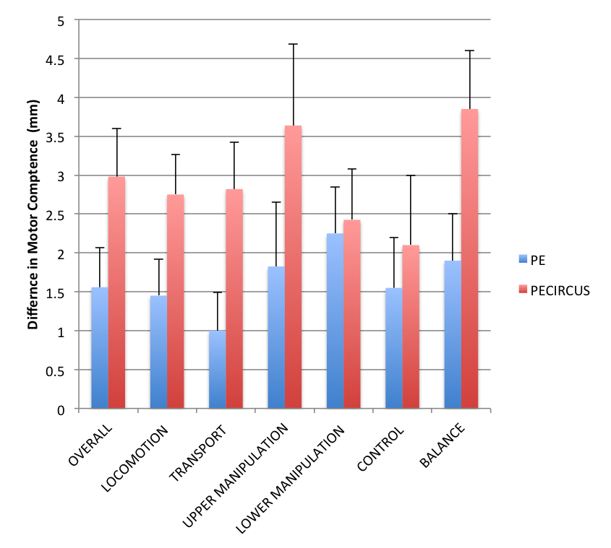
Motor Competence

Slide 10
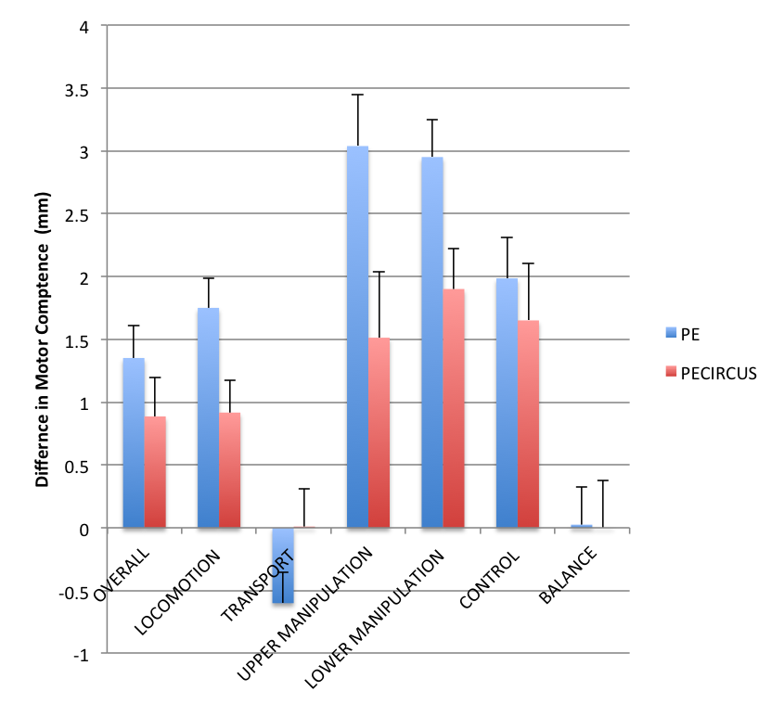
Gender Gap

Slide 11
Findings/Play Self & Coach
Children in circus (Self reported)
Feel they are talented!
Are more eager and motivated to participate, especially females.
Accept the importance of learning new movements
Feel they comprehend movement terminology.
Coaches/teachers see children in circus as having higher
Confidence, motivation, comprehension, and diverse movements

Slide 12
National Endowment for the Arts
The Arts and Achievement in At-Risk Youth: Findings from Four Longitudinal Studies
Examines the academic and civic behavior outcomes of youth who have engaged deeply with the arts in or out of school (high arts)
With a specific focus on youth who came from lower socioeconomic status (low-SES) backgrounds
http://arts.gov/sites/default/files/Arts-At-Risk-Youth.pdf

Slide 13
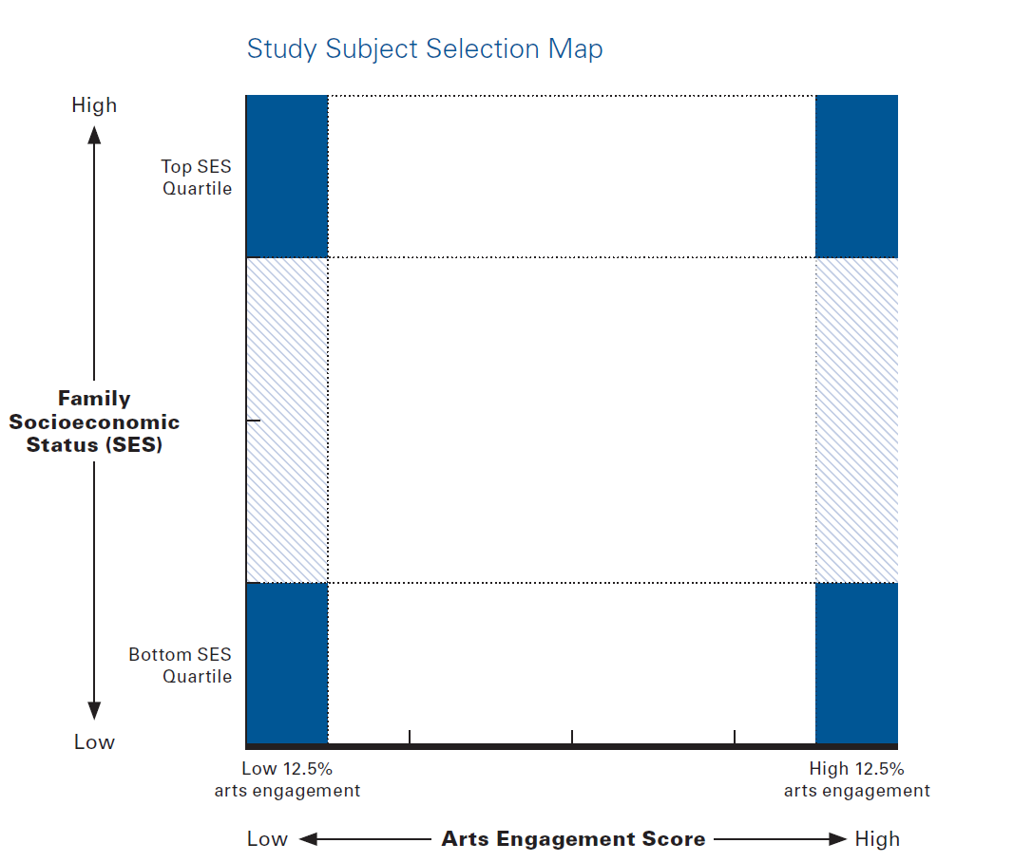

Slide 14
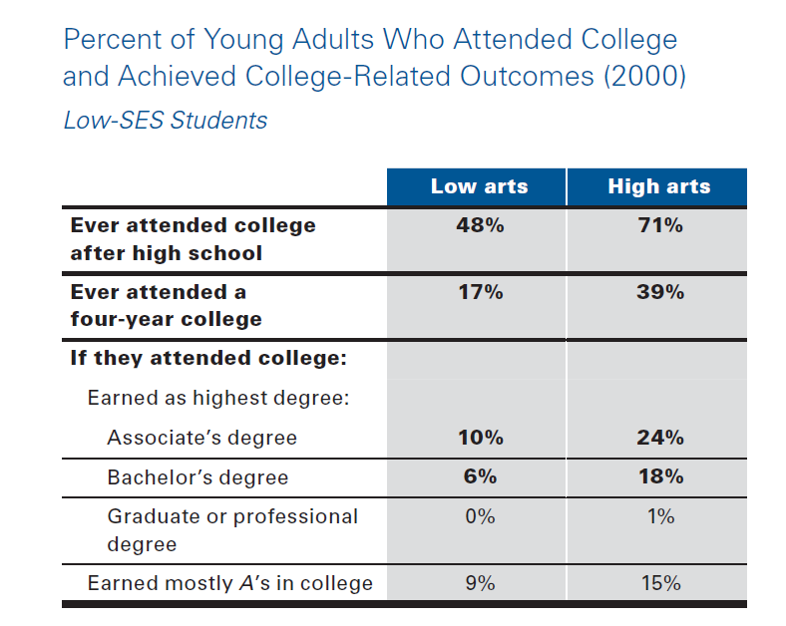

Slide 15
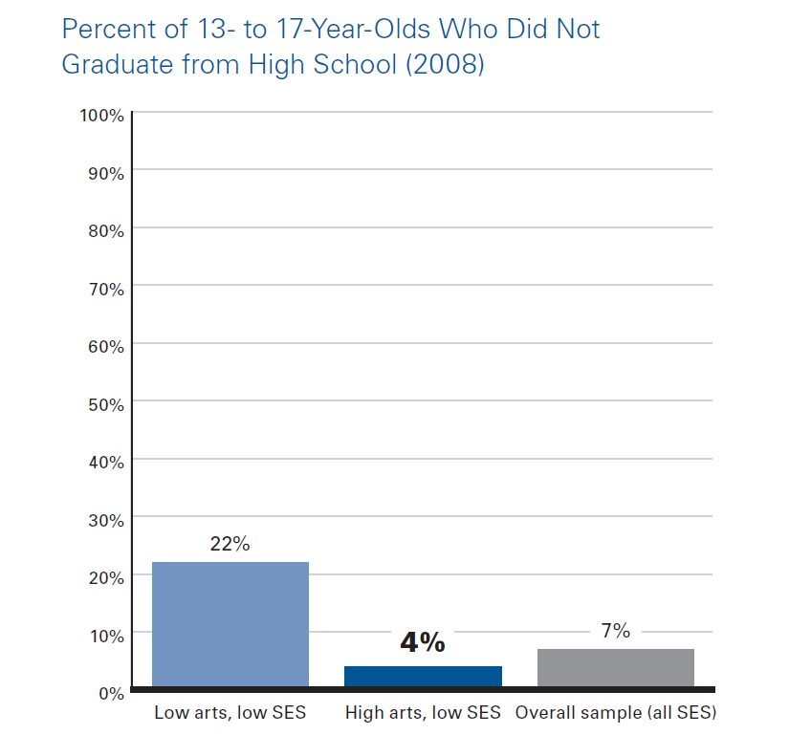
Academic Achievement

Slide 16
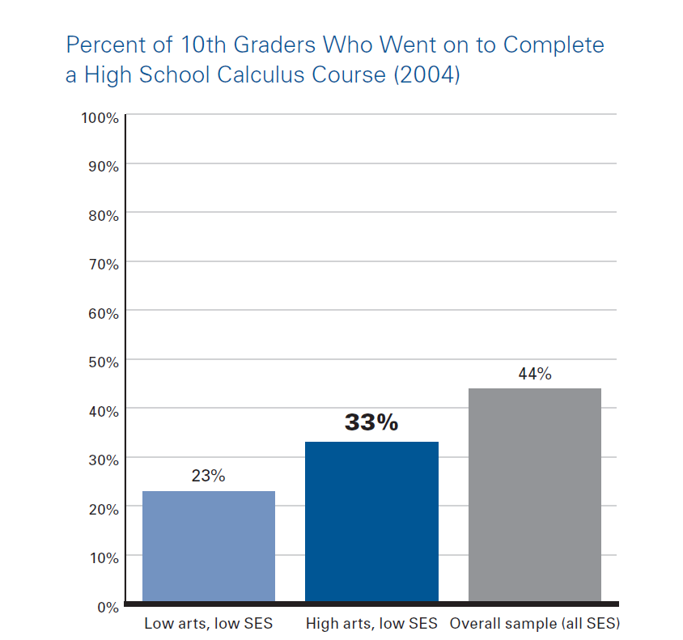
Academic Achievement

Slide 17
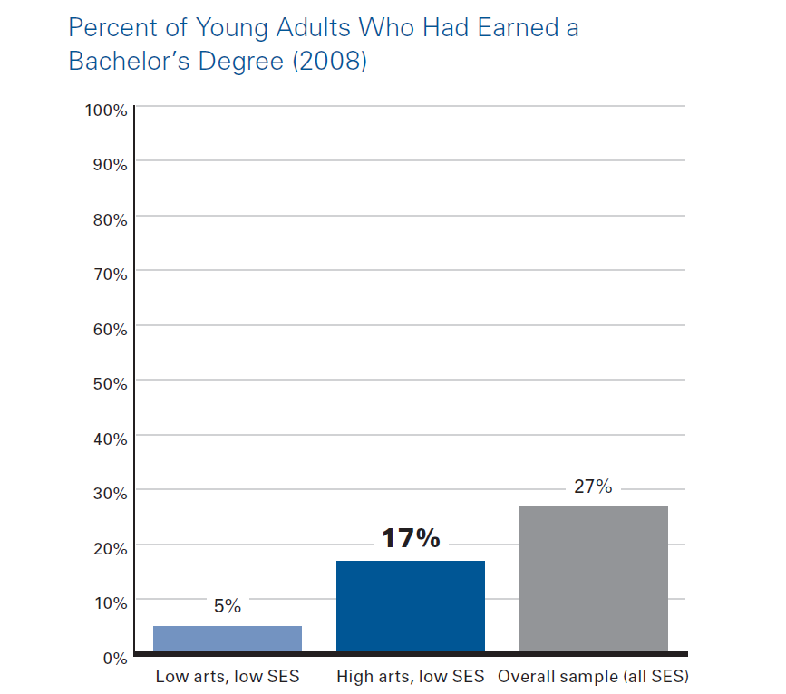
Academic Achievement

Slide 18
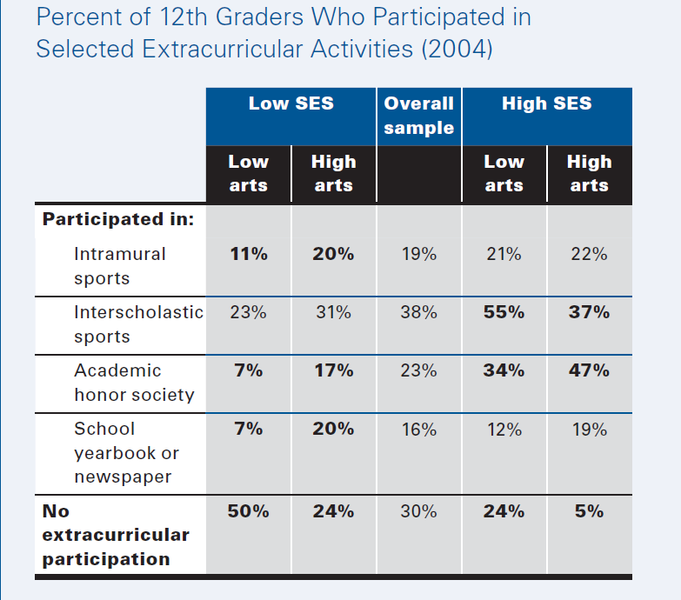
Social Participation

Slide 19
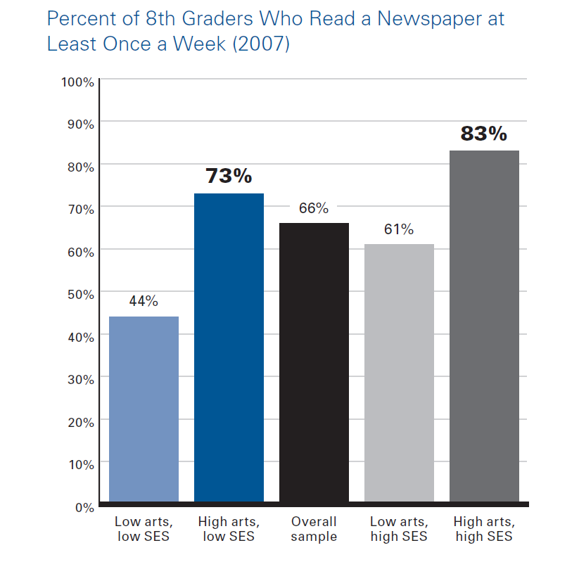
Civic Engagement

Slide 20
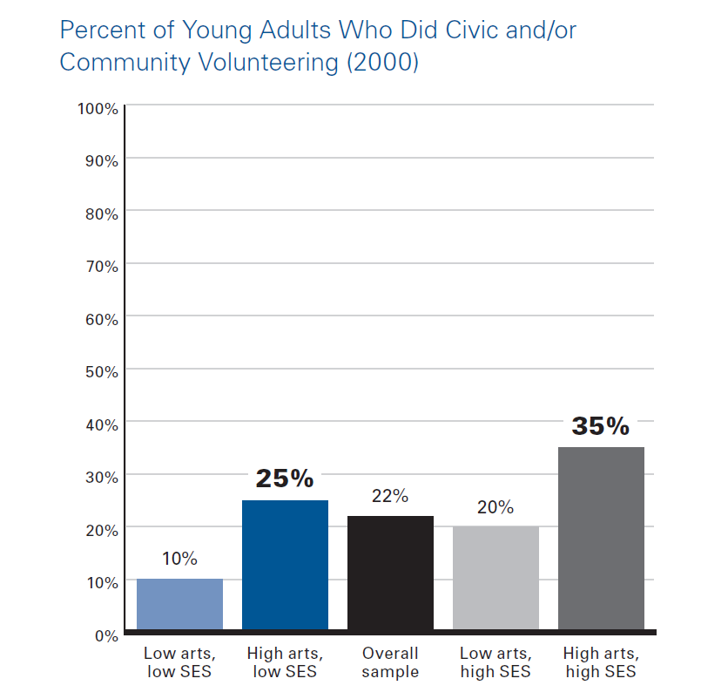
Civic Engagement

Slide 21
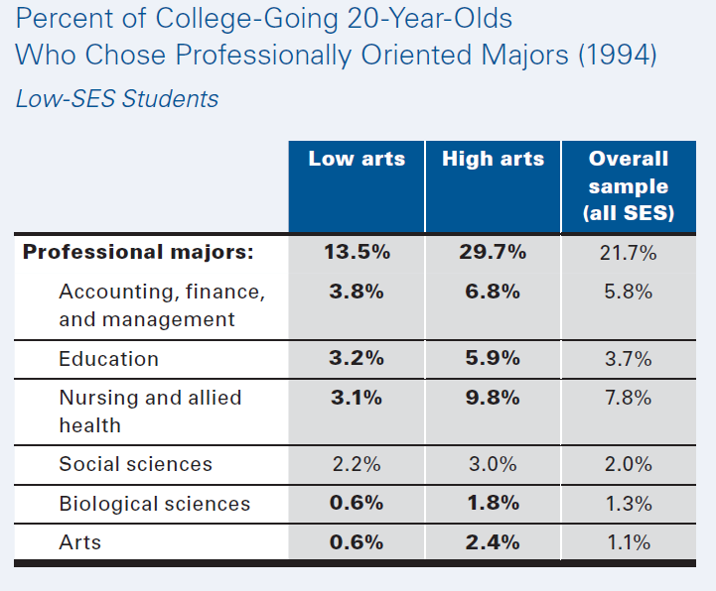
Professional Outcomes

Slide 22
Report on the Questionnaire Survey (56) Conducted
among Social Circus Participants at the
“Rassemblement” Event, Quebec, May, 2014
Prepared by
Dr. Jennifer Spiegel, Concordia University

Slide 23
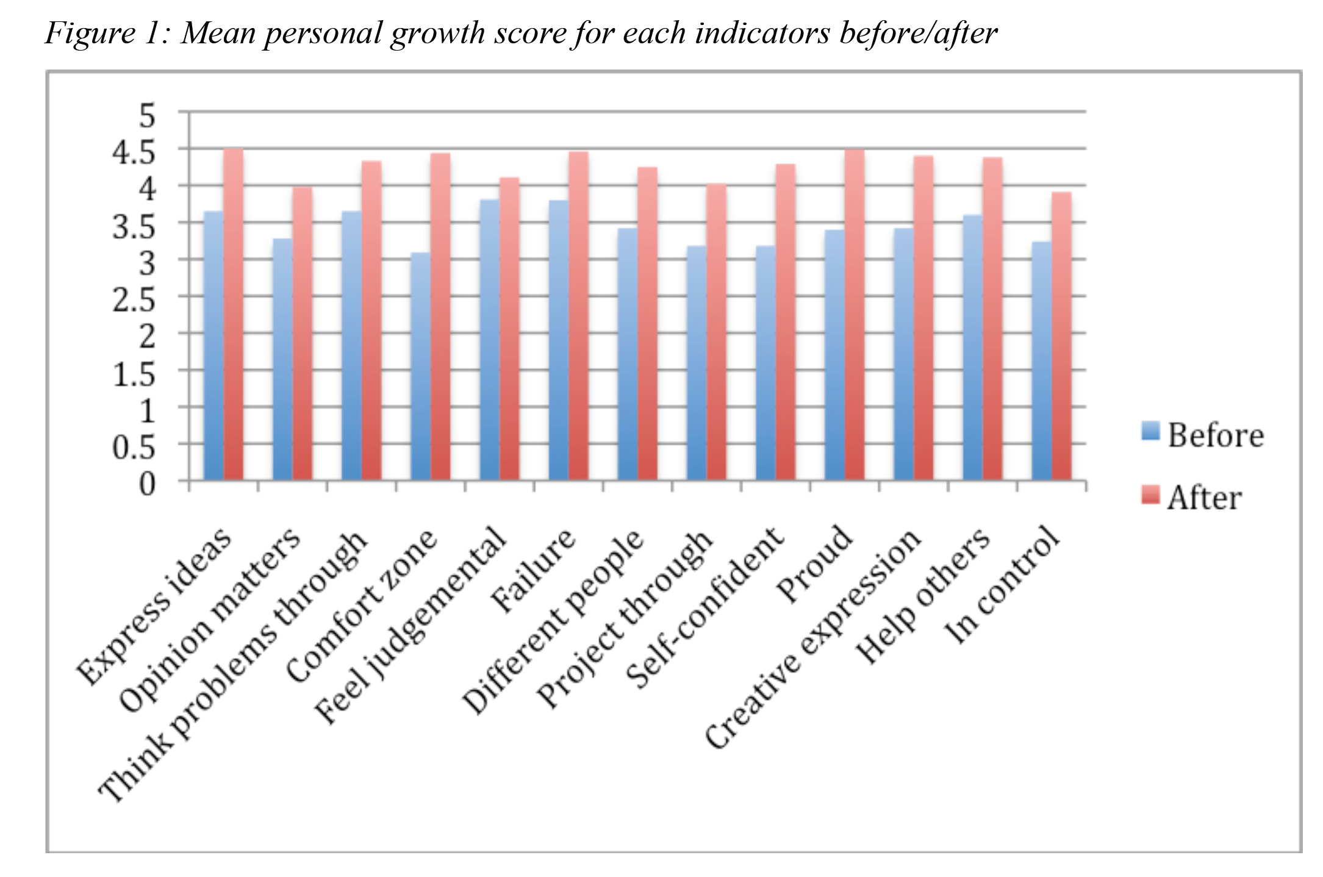
Personal Growth

Slide 24
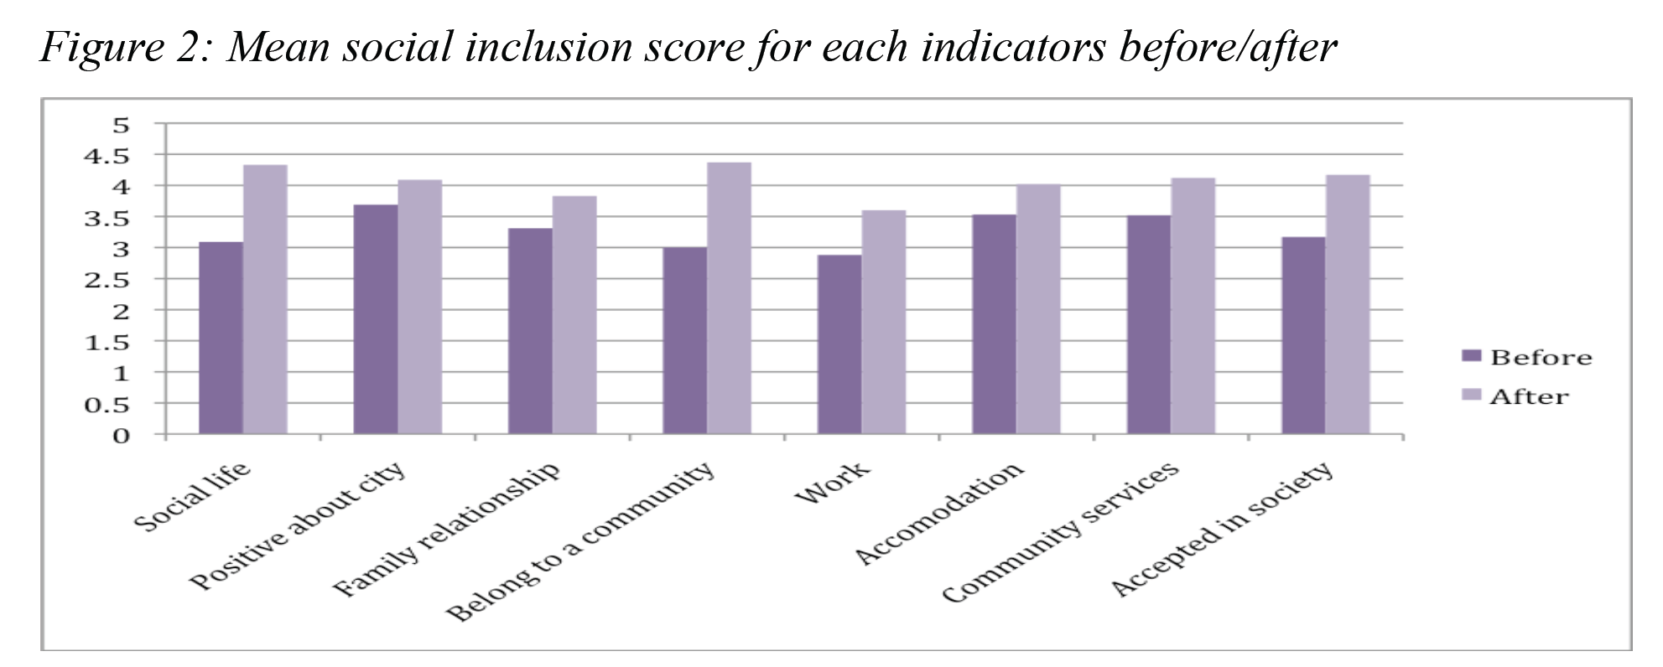
Social Inclusion

Slide 25
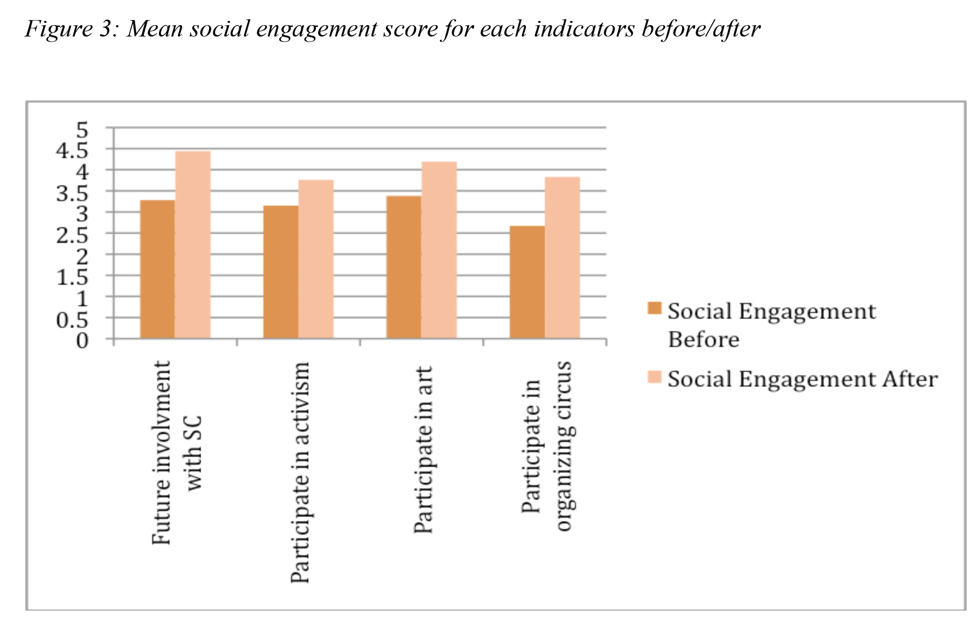
Social Engagement

Slide 26
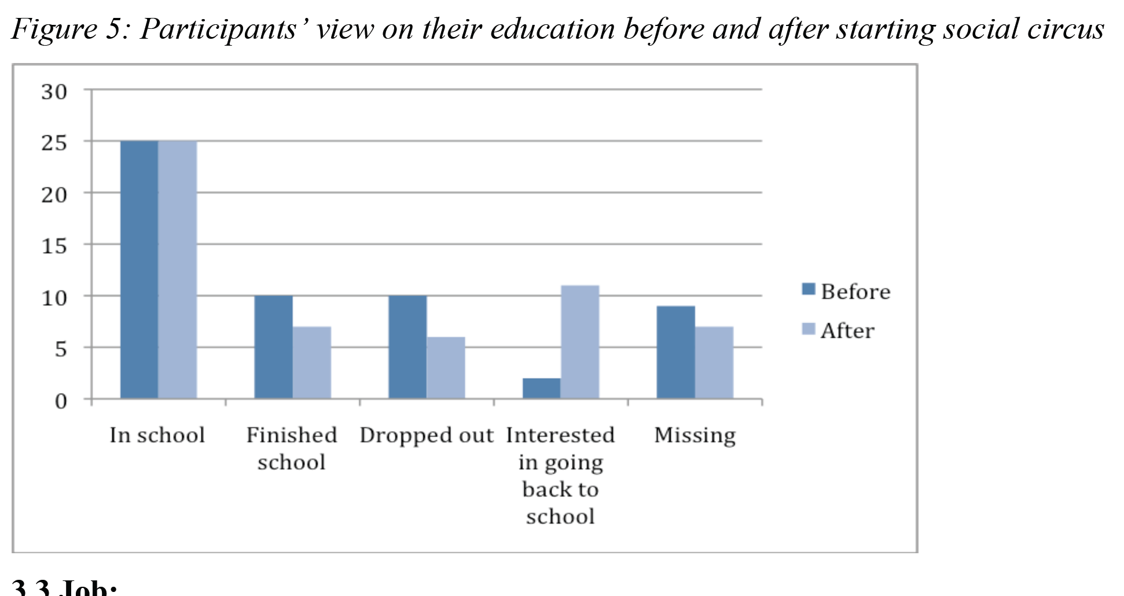
View on Education

Slide 27
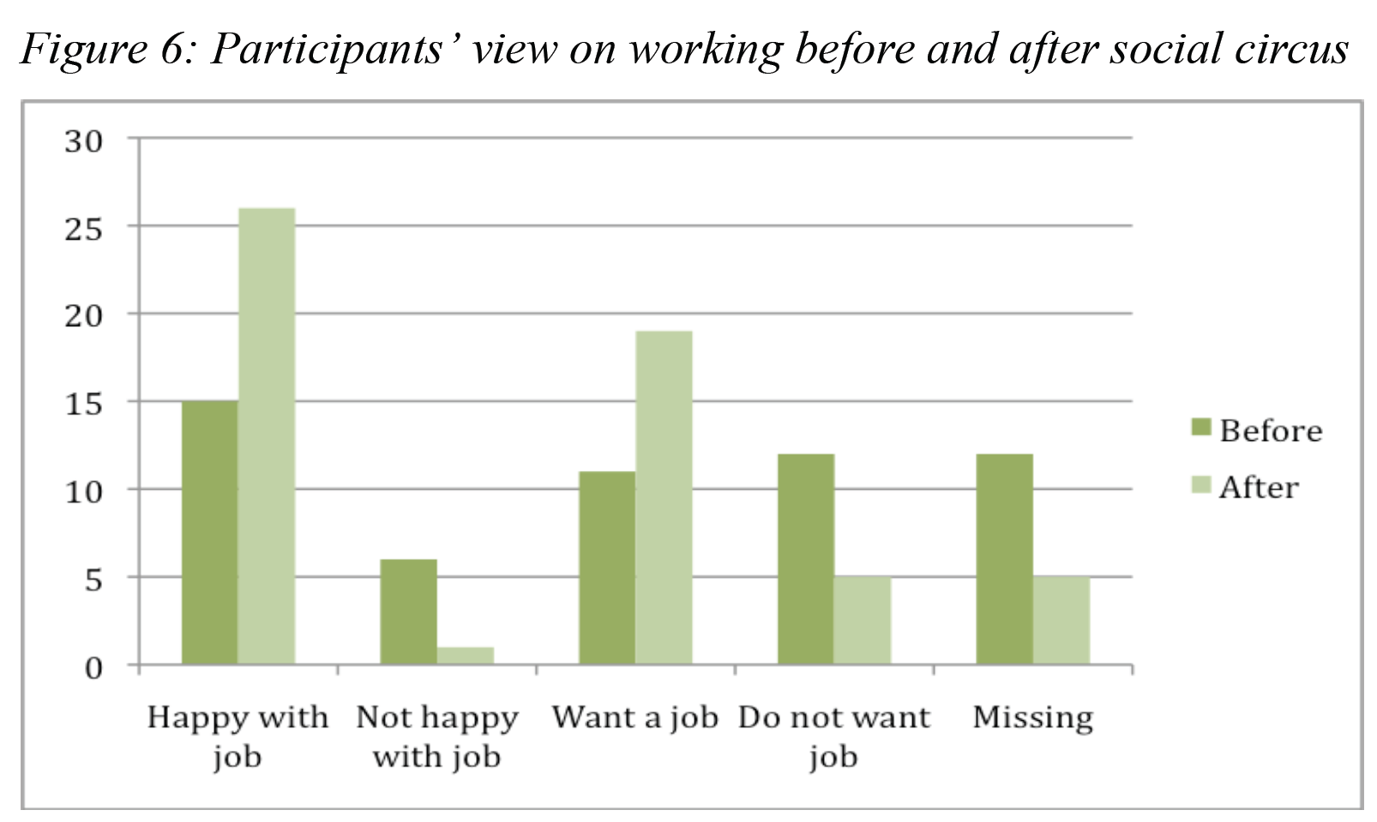
View on Working

Slide 28
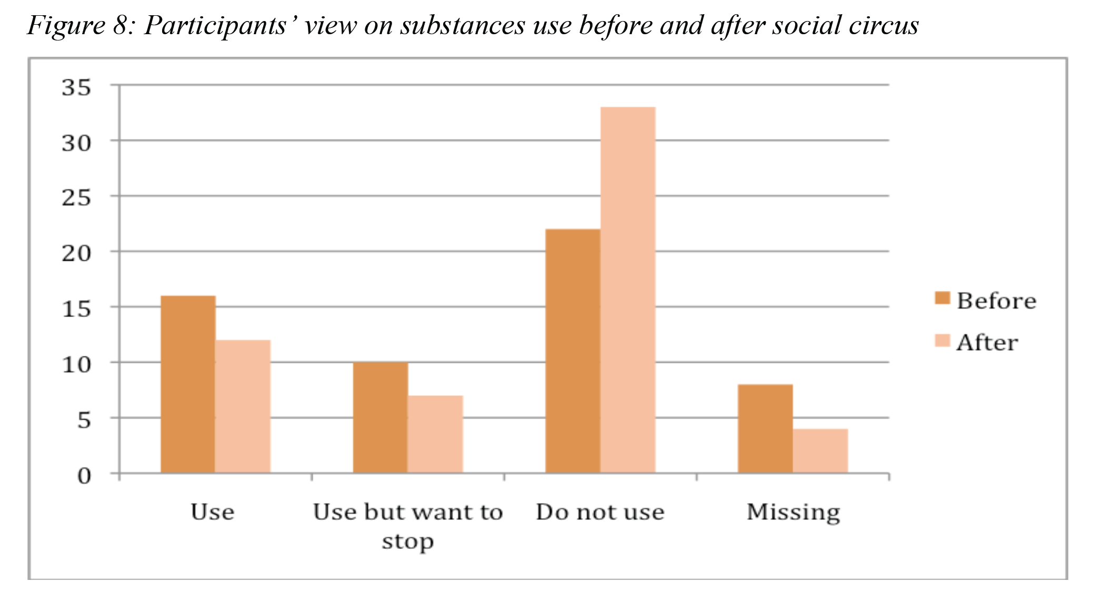
View on Substance Use

Slide 29
In light of these results, do you think it’s relevant to share research findings during training ? And why?
How can we integrate the research topic in the training ?

